Slide 1

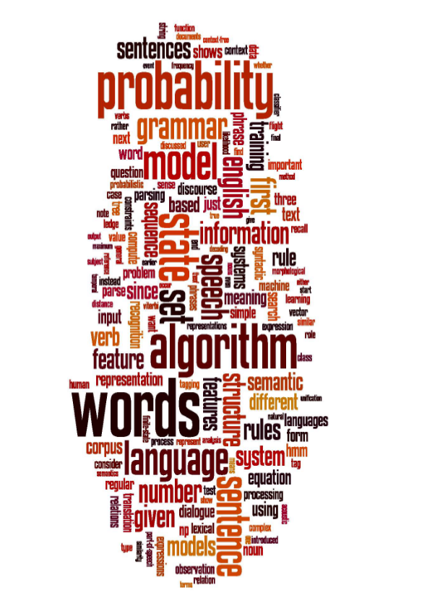
18CSE359T – Natural Language Processing “Enabling Computers to Understand Natural Language like Humans”
Department of Computational Intelligence
School of computing
SRM Institute of Science and Technology

Slide 2
Course Objectives
Teach students the leading trends and systems in natural language processing.
Make them understand the concepts of morphology, syntax, semantics and pragmatics of the language and that they are able to give the appropriate examples that will illustrate the above mentioned concept.
Teach them to recognize the significance of pragmatics for natural language understanding.
Enable students to be capable to describe the application based on natural language processing and to show the points of syntactic, semantic and pragmatic processing.
To understand natural language processing and to learn how to apply basic algorithms in this field.

Slide 3
Course Outcomes
CO1: Construct approaches to syntax and semantics in NLP.
CO2: : Analyze approaches to syntax and semantic parsing with pronoun resolution.
CO3: Implement semantic role, relations and frames, Including co reference resolution.
CO4: Implement summarization, Information retrieval and machine translation.
CO5: Apply the knowledge of various levels of analysis involved in NLP and Implement
different techniques of NLP like word Embedding, CBOW and Skip-gram

Slide 4
NLP
Unit I - Introduction to NLP
Unit II - Syntax parsing
Unit III - Semantic relations
Unit IV - Information extraction
Unit V - Statistical & Probabilistic approaches to NLP tasks

Slide 5
UNIT 1 -Topics
Introduction to Natural Language Processing
Steps – Morphology – Syntax – Semantics
Morphological Analysis (Morphological Parsing)
Stemming – Lemmatization
Parts of Speech Tagging
Approaches on NLP Tasks (Rule-based, Statistical, Machine Learning
N-grams
Multiword Expressions
Collocations (Association Measures, Coefficients and Context Measure
Vector Representation of Words
Language Modelling

Slide 6
Introduction to NLP
Motive of learning a language is to communicate and share the information successfully to others.
According to the industry the estimation is only 21% of the available data is in the structured form.
Data is being generated ,send messages on WhatsApp and Facebook or various social media.
Majority of the datas exists in textual format which is highly unstructured form.
Now in order to produce significant and actionable insights from this data it is important to get acquainted with the techniques of text analysis and natural language processing.

Slide 7
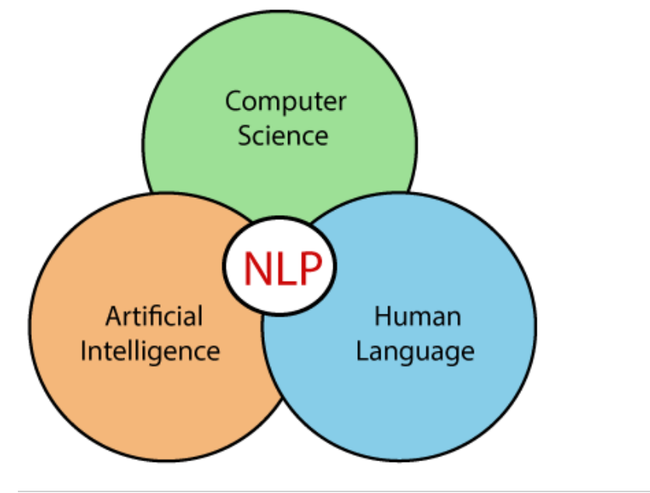
Introduction to NLP
Text analytics/mining is the process of deriving meaningful information from natural language text.
It usually involves the process of structuring the input text, deriving patterns and evaluating and interpreting the output.
Natural language processing is a part of computer science and artificial intelligence which deals with human languages.

Slide 8
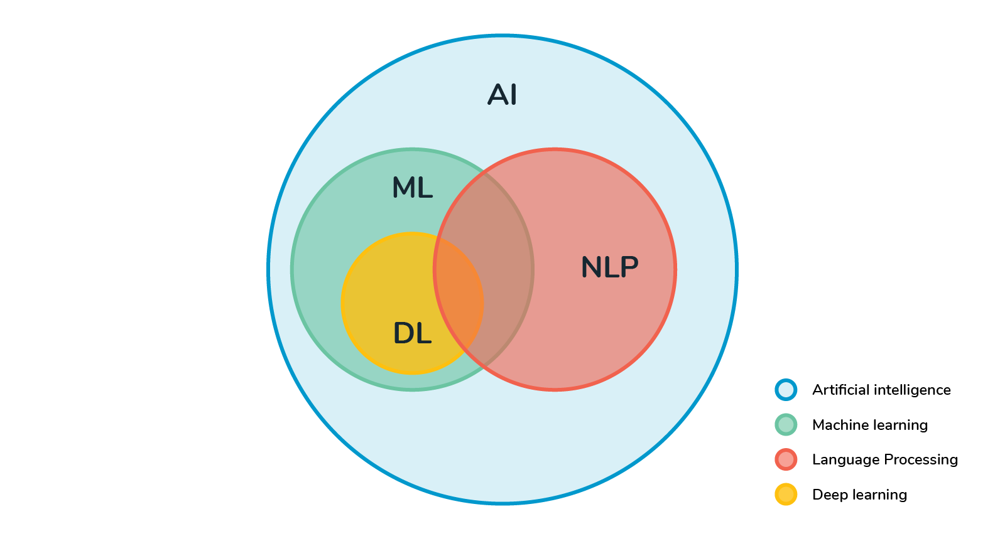
What is NLP?
Natural language processing (NLP) is a branch of artificial intelligence (AI) that enables machines to understand human language.
The main intention of NLP is to build systems that are able to make sense of text and audio
Then automatically execute tasks like spell-check, text translation, topic classification, etc.

Slide 9
Need of NLP
The need to study Natural Language Processing (NLP)
Increasing role of language in human-computer interaction
Vast amount of unstructured textual data available.
Now to make interactions between computers and humans, computers need to understand natural languages used by humans.
Natural language processing is all about making computers learn, process, and manipulate natural languages.

Slide 10
Need of NLP
Processing text data is an essential task as there is an abundance of text available everywhere.
Text data can be found in various sources such as books, websites, social media, news articles, research papers, emails, and more.
However, text data is often unstructured, meaning it lacks a predefined format or organization.
To harness the valuable information contained within text data, it is necessary to process and analyze it effectively.

Slide 11
Need of NLP
To extract insights, identify patterns, perform sentiment analysis, categorize documents, automate text generation, and enable information retrieval.
By processing text data, valuable knowledge can be derived, enabling businesses, researchers, and individuals to make informed decisions, gain insights, improve customer experiences, develop intelligent systems, and drive innovation across various industries.

Slide 12
Use of NLP
User-Friendly Interfaces: NLP allows for intuitive and user-friendly interfaces using natural language, reducing the need for complex programming syntax.
Accessibility and Inclusivity: NLP makes technology accessible to a wider audience, including those with limited technical expertise or disabilities.
Conversational Systems: NLP enables the development of conversational agents, enhancing user interaction and system efficiency.
Data Extraction and Analysis: NLP extracts insights from unstructured text data, enabling sentiment analysis, information retrieval, and text summarization.
Voice-based Interaction: NLP powers voice assistants and speech recognition systems for hands-free and natural interaction.
Human-Machine Collaboration: NLP enables seamless communication and collaboration between humans and machines.
Natural Language Understanding: NLP allows machines to comprehend context, semantics, and intent, enabling advanced applications and personalized experiences.

Slide 13
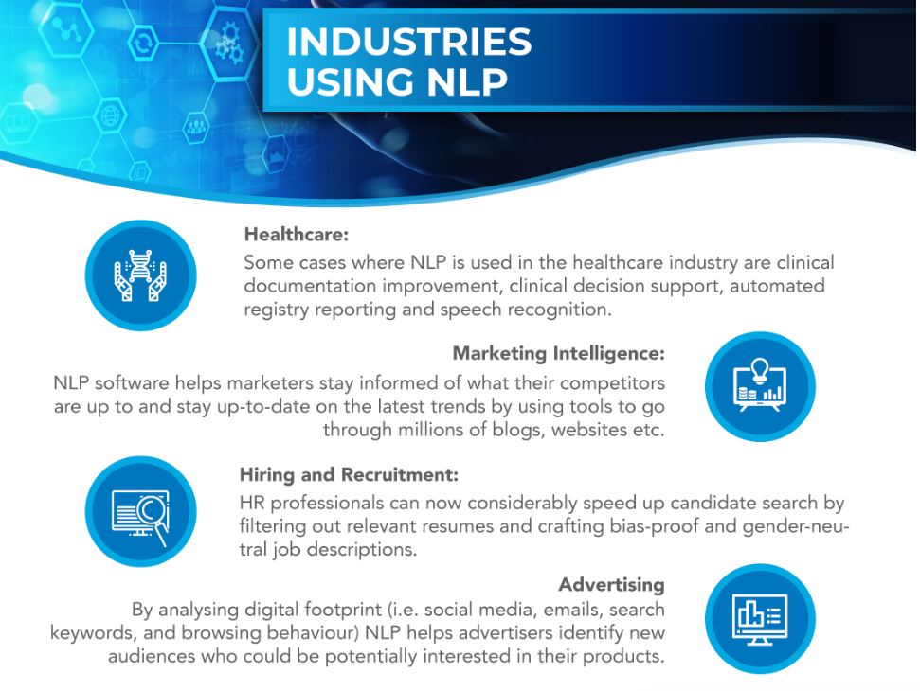
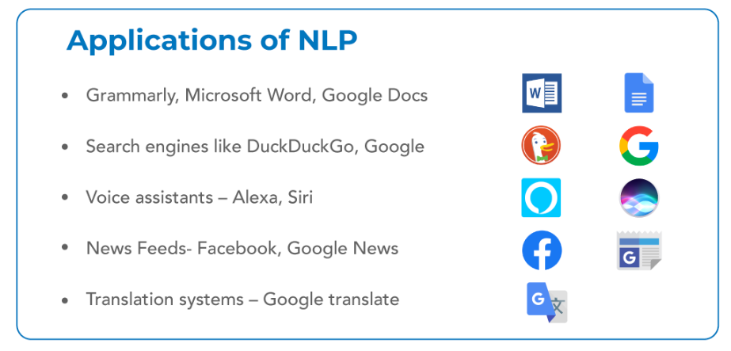
Applications of NLP

Slide 14
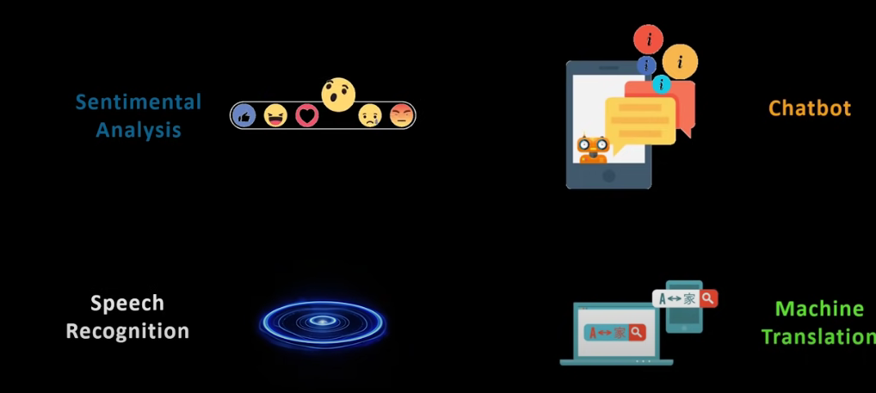
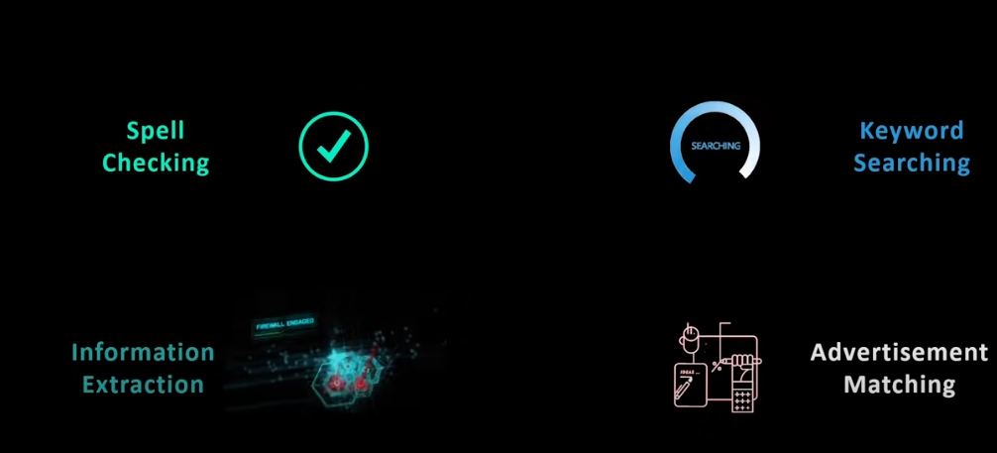
Applications of NLP

Slide 15

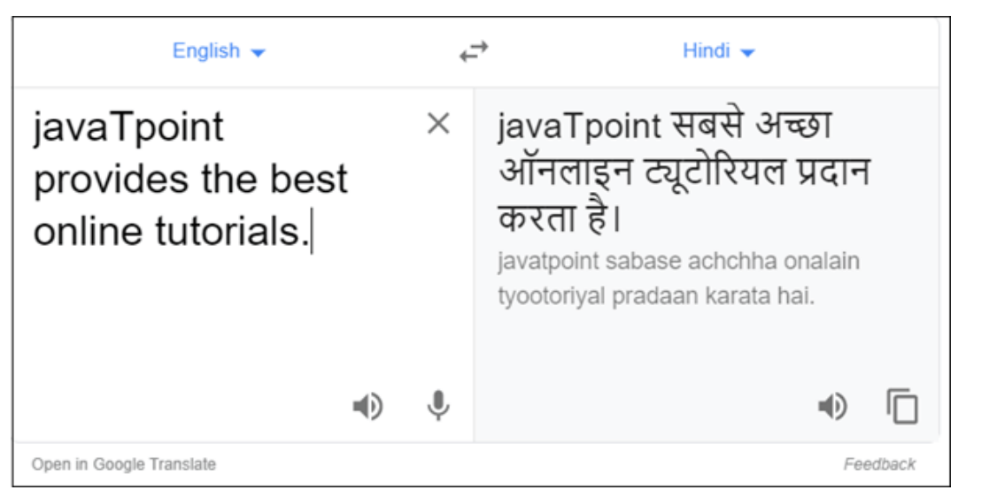
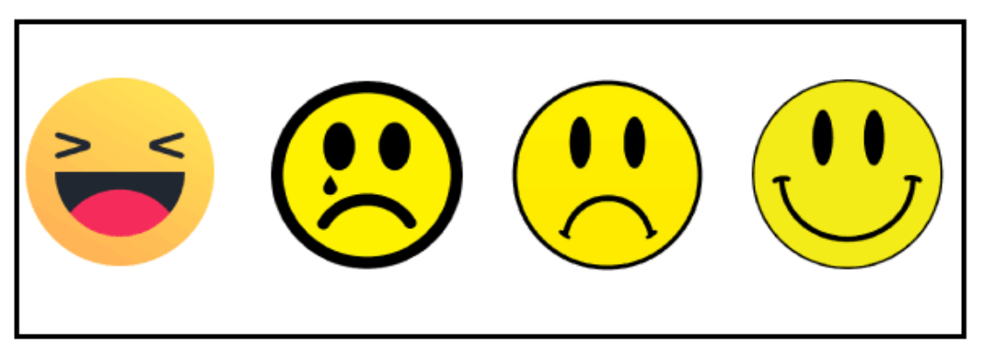
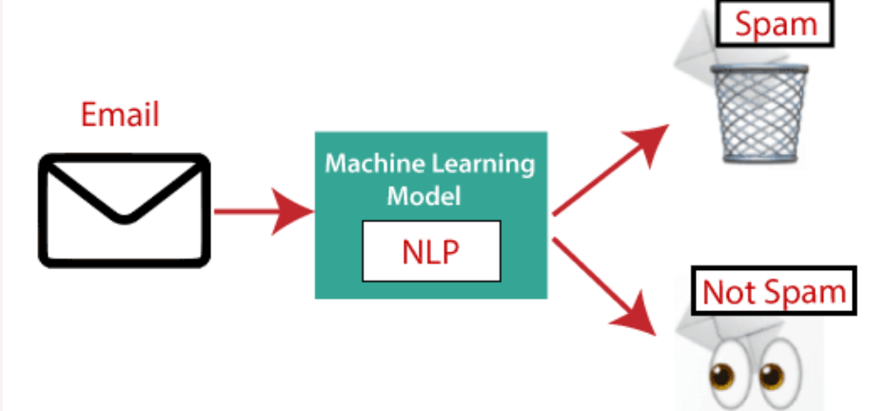
Applications of NLP
Twitter sentimental analysis or the Facebook sentiment as it's being used heavily now.
Customer chat services provided by various companies and the process behind all of that is because of the NLP.
Speech recognition are also talking about divorce assistants like Google assistant and alexa.
NLP to translate data from one language to another
Advertisement matching basically recommendation of ads based on your history.

Slide 16
Real life use cases of NLP
Gmail - when u r typing any sentence in gmail you will notice that it tries to auto complete. Auto completion is done using NLP.
Spam filters - This emails didn’t have spam filters then you will be so much worried you will get so much mails/headache. Using NLP we can filter them and using keywords take them out of your inbox.
Language translation - Translate sentence from one language to another language.
Customer service chat bot - ex: in bank service chat bot if you type in a message and many times there is no human on the other hand. Your chat bot can interpret your language it can derive intent out of it and it can respond to your question on its own and sometimes it doesn’t work well then they connect it to human beings.
Voice assistants at amazon, alexa and google assistant
Google search - BERT special language model will give a correct solution for all search question.

Slide 17
Advantages of NLP
NLP helps users to ask questions about any subject and get a direct response within seconds.
NLP offers exact answers to the question means it does not offer unnecessary and unwanted information.
NLP helps computers to communicate with humans in their languages.
It is very time efficient.
Most of the companies use NLP to improve the efficiency of documentation processes, accuracy of documentation, and identify the information from large databases.

Slide 18
Disadvantages of NLP
NLP may not show context.
NLP is unpredictable
NLP may require more keystrokes.
NLP is unable to adapt to the new domain, and it has a limited function that's why NLP is built for a single and specific task only.

Slide 19
Components of NLP
Natural Language Understanding (NLU)
Natural Language Understanding (NLU) helps the machine to understand and analyse human language by extracting the metadata from content such as concepts, entities, keywords, emotion, relations, and semantic roles.
NLU mainly used in Business applications to understand the customer's problem in both spoken and written language.
NLU involves the following tasks -
It is used to map the given input into useful representation.
It is used to analyze different aspects of the language.

Slide 20
Components of NLP
2. Natural Language Generation (NLG)
Natural Language Generation (NLG) acts as a translator that converts the computerized data into natural language representation.
It mainly involves Text planning, Sentence planning, and Text Realization.

Slide 21
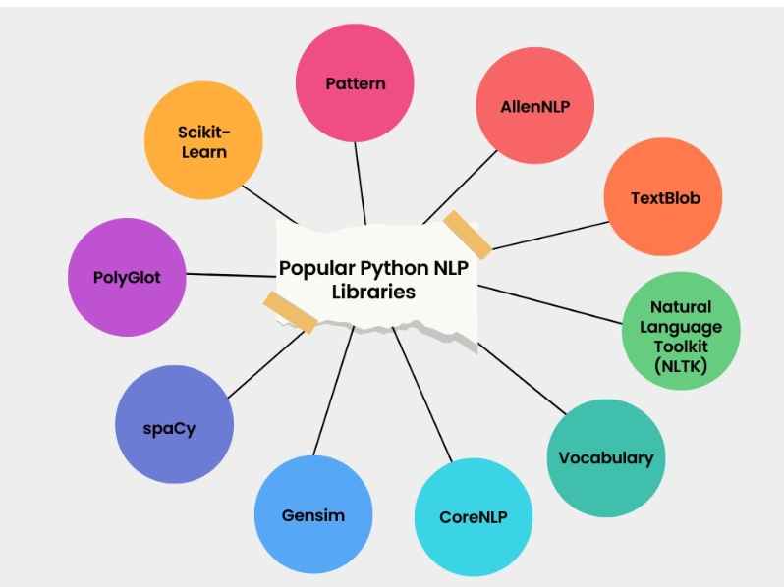
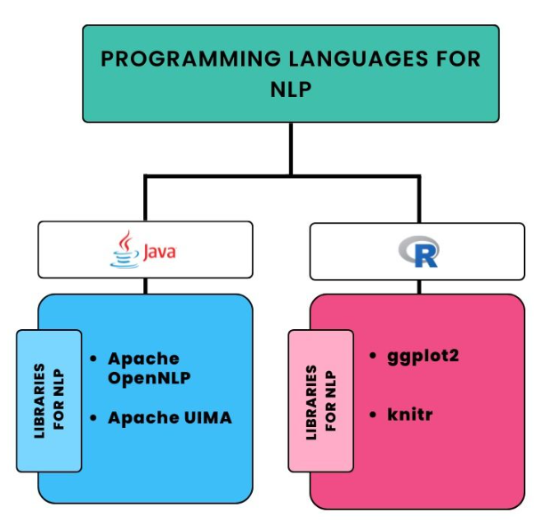
Programming Languages for NLP
list of NLP APIs

Slide 22
NLP Libraries
Scikit-learn: It provides a wide range of algorithms for building machine learning models in Python.
Natural language Toolkit (NLTK): NLTK is a complete toolkit for all NLP techniques.
Pattern: It is a web mining module for NLP and machine learning.
TextBlob: It provides an easy interface to learn basic NLP tasks like sentiment analysis, noun phrase extraction, or pos-tagging.
Quepy: Quepy is used to transform natural language questions into queries in a database query language.
SpaCy: SpaCy is an open-source NLP library which is used for Data Extraction, Data Analysis, Sentiment Analysis, and Text Summarization.
Gensim: Gensim works with large datasets and processes data streams.

Slide 23
List of NLP APIs
IBM Watson API IBM Watson API combines different sophisticated machine learning techniques to enable developers to classify text into various custom categories.
Chatbot API Chatbot API allows you to create intelligent chatbots for any service.
Speech to text API Speech to text API is used to convert speech to text
Text Analysis API by AYLIEN Text Analysis API by AYLIEN is used to derive meaning and insights from the textual content.
Cloud NLP API The Cloud NLP API is used to improve the capabilities of the application using natural language processing technology.

Slide 24
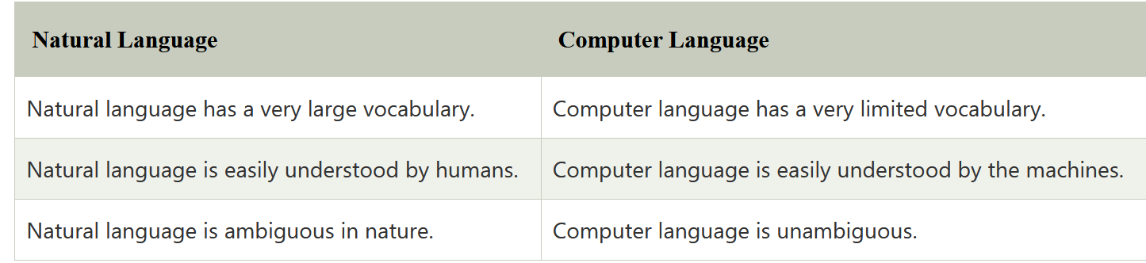
Difference between Natural language and Computer Language

Slide 25
Student Evaluation MCQ
1)What is the field of Natural Language Processing (NLP)? a) Computer Science b) Artificial Intelligence c) Linguistics d) All of the mentioned
2)What is the main challenge/s of NLP? a) Handling Ambiguity of Sentences b) Handling Tokenization c) Handling POS-Tagging d) All of the mentioned
3) What is Machine Translation? a) Converts one human language to another b) Converts human language to machine language c) Converts any human language to English d) Converts Machine language to human language
4)Natural language processing is divided into the two subfields of -
A. symbolic and numeric B. algorithmic and heuristic
C. time and motion D. understanding and generation
5). The natural language is also known as .....................
A. 3rd Generation language B. 4th Generation language
C. 5th Generation language D. 6th Generation language

Slide 26
Process of NLP
Morphological Analysis/ Lexical Analysis
Syntax Analysis
Semantic Analysis
Discourse
Pragmatics
Lexical Analysis
Syntax Analysis
Semantic Analysis
Discourse
Pragmatics

Slide 27
Morphological Analysis/ Lexical Analysis
Morphological or Lexical Analysis deals with text at the individual word level.
It looks for morphemes, the smallest unit of a word.
The first phase of NLP is the Lexical Analysis.
This phase scans the source code as a stream of characters and converts it into meaningful lexemes.
It divides the whole text into paragraphs, sentences, and words.
For example, irrationally can be broken into ir (prefix), rational (root) and -ly (suffix).
Lexical Analysis finds the relation between these morphemes and converts the word into its root form.
A lexical analyzer also assigns the possible Part-Of-Speech (POS) to the word.
It takes into consideration the dictionary of the language.
For example, the word “character” can be used as a noun or a verb.

Slide 28
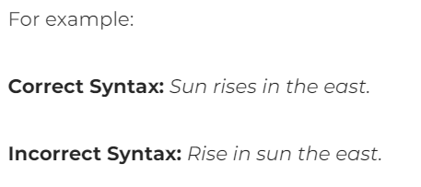
Syntax Analysis
Syntax Analysis ensures that a given piece of text is correct structure. It tries to parse the sentence to check correct grammar at the sentence level.
Given the possible POS generated from the previous step, a syntax analyzer assigns POS tags based on the sentence structure.

Slide 29
Syntax
Syntax refers to the arrangement of words in a very sentence specified they create grammatical sense.
Syntax techniques
Lemmatization It entails reducing the various inflected forms of a word into a single form for easy analysis.
Morphological segmentation It involves dividing words into individual units called morphemes.
Word segmentation It involves dividing a large piece of continuous text into distinct units.
Part-of-speech tagging It involves identifying the part of speech for every word.
Parsing It involves undertaking a grammatical analysis for the provided sentence.
Sentence breaking It involves placing sentence boundaries on a large piece of text.
Stemming It involves cutting the inflected words to their root form.

Slide 30
Semantics
Semantics refers to the meaning that is conveyed by a text. It involves the interpretation of words and how sentences are structured.
Named entity recognition (NER) It involves determining the parts of a text that can be identified and categorized into preset groups. Examples of such groups include names of individuals and names of places.
Word sense disambiguation It involves giving meaning to a word based on the context.

Slide 31
Semantic Analysis
Consider the sentence: “The apple ate a banana”. Although the sentence is syntactically correct, it doesn’t make sense because apples can’t eat.
Semantic analysis looks for meaning in the given sentence. It also deals with combining words into phrases.
For example, “red apple” provides information regarding one object; hence we treat it as a single phrase.
Similarly, we can group names referring to the same category, person, object or organization. “Robert Hill” refers to the same person and not two separate names – “Robert” and “Hill”

Slide 32
Discourse
Discourse deals with the effect of a previous sentence on the sentence in consideration. In the text, “Jack is a bright student. He spends most of the time in the library.” Here, discourse assigns “he” to refer to “Jack”.
Pragmatics
The final stage of NLP, Pragmatics interprets the given text using information from the previous steps. Given a sentence, “Turn off the lights” is an order or request to switch off the lights.

Slide 33
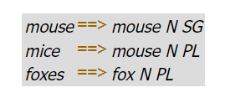
Morphological Analysis (Morphological Parsing)
The goal of morphological parsing is to find out what morphemes a given word is built from.
The goal of morphological parsing is to find out what morphemes a given word is built from. For example, a morphological parser should be able to tell us that the word cats is the plural form of the noun stem cat, and that the word mice is the plural form of the noun stem mouse. So, given the string cats as input, a morphological parser should produce an output that looks similar to cat N PL. Here are some more examples:

Slide 34
Morphological Analysis (Morphological Parsing)
Morphological parsing yields information that is useful in many NLP applications. In parsing, e.g., it helps to know the agreement features of words. Similarly, grammar checkers need to know agreement information to detect such mistakes.
But morphological information also helps spell checkers to decide whether something is a possible word or not, and in information retrieval it is used to search not only cats, if that's the user's input, but also for cat.

Slide 35
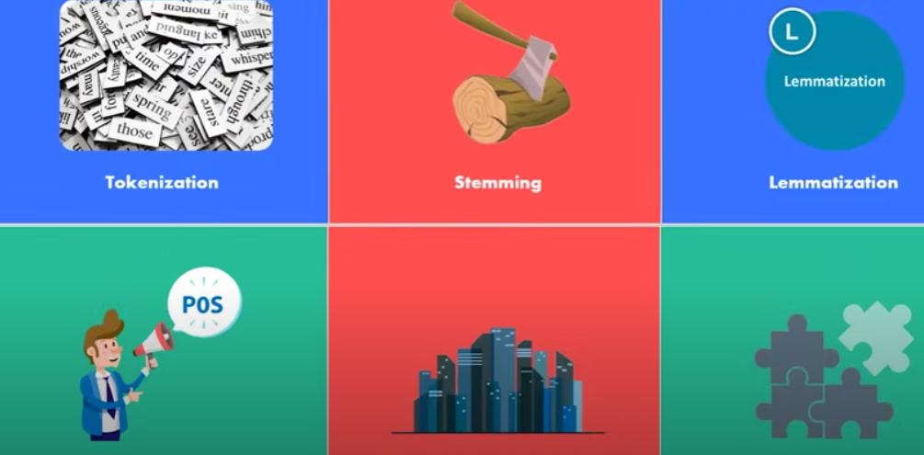
Pipeline of NLP in AI /Steps in NLP
Tokenization
Stemming
Lemmatization
POS tags
Named Entity Recognition
Chunking

Slide 36
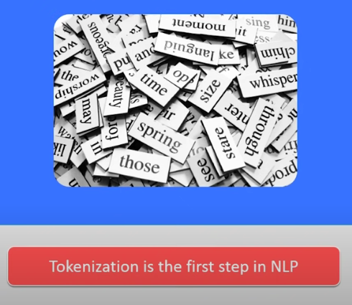
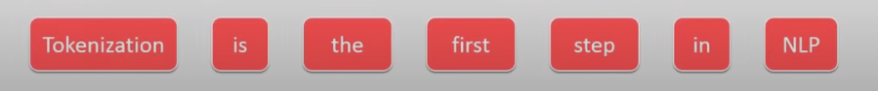
Tokenization
Process the strings into tokens. Tokens is like a small structures or units.

Slide 37

Stemming
Normalize words into its base or root form.
stemming algorithm works by cutting off the end or the beginning of the word taking into account a list of common prefixes suffixes that can be found in an infected word.
Here the single root word is affect.

Slide 38
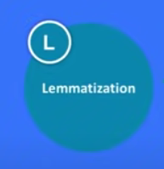
Lemmatization
Morphological analysis of the word to do so its necessary to have a detail dictionary and the algorithm can look through to link the original word or root word.
Somehow similar to stemming, as it maps several words into one common root.
Output of lemmatization is proper word.
For example, Lemmatizer should map gone,going and went into go.

Slide 39

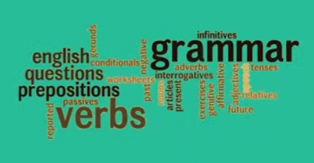
POS tags
Speaking the grammatical type of the word is referred to as POS tags or parts of speech.
Nouns, pronouns, verbs, adverbs, adjectives, prepositions, Conjunctions and Interjections.

Slide 40
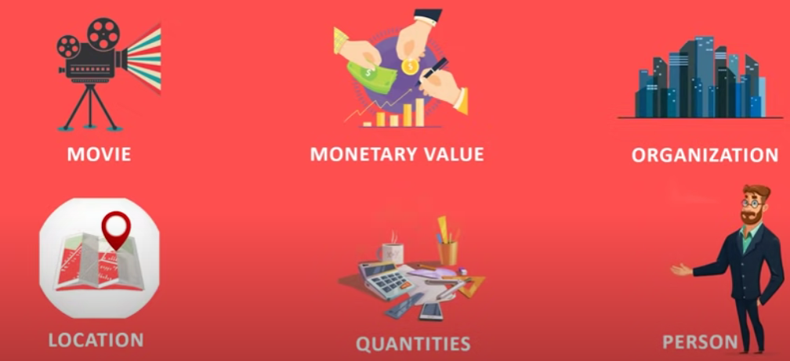
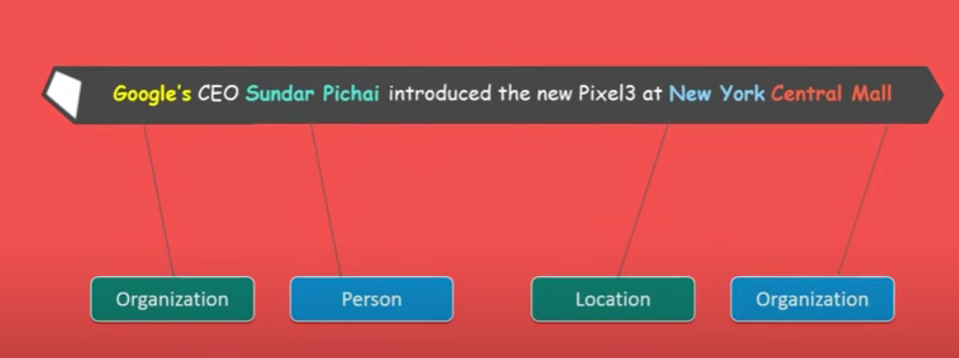
Named Entity Recognition
Process of detecting the named entities such as the person name, company name and location that is pharse identification.

Slide 41
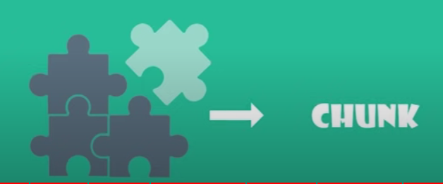
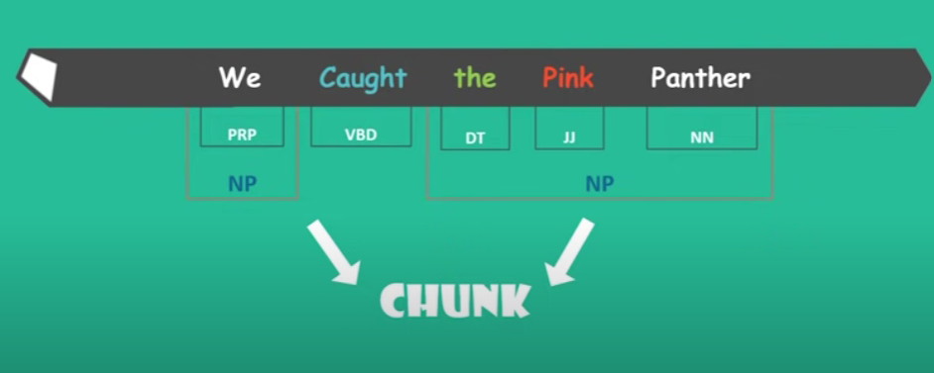
Chunking
Picking up individual pieces of information and grouping them into bigger pieces.
Grouping of words or tokens.

Slide 42
Why is NLP hard?
ambiguity and variability of linguistic expression:
variability: many forms can mean the same thing
ambiguity: one form can mean many things
Many different kinds of ambiguity
Each NLP task has to address a distinct set of kinds

Slide 43
Steps – Morphology – Syntax – Semantics
Language - smallest individual unit
Phoneme - Single distinguishable sound
Morphology - word formation

Slide 44
Morphology
Morphology helps linguists understand the structure of words by putting together morphemes.
A morpheme is the smallest grammatical, meaningful part of language.
2 types - Free morpheme and Bound morpheme.
A free morpheme is a single meaningful unit of a word that can stand alone in the language. For example: cat, mat, trust, slow.
A bound morpheme cannot stand alone, it has no real meaning if it is on its own. For example: walked, (ed) can not stand alone or unpleasant (un) is not a stand alone morpheme.Bound morphemes that are part of prefixes and suffixes.
Bound morphemes can also be grouped into into a further two categories.
1. Derivational 2. Inflectional
Notes:
A morpheme is the smallest grammatical, meaningful part of language. There are two different types of morphemes that form the basis of the words they structure. They are known as a free morpheme and a bound morpheme. A free morpheme is a single meaningful unit of a word that can stand alone in the language.
Bound morphemes that are part of the beginning of a word are known as prefixes and at the end of a word they are known as suffixes.

Slide 45
Derivational
Added to the base form of the word to create a new word.
Look at the word able and let it become ability. In this instance the adjective becomes a noun.
The word send as a verb morpheme becomes sender and a noun with the addition of er.
While stable to unstable changes the meaning of the word to become the opposite meaning.
In other words the meaning of the word is completely changed by adding a derivational morpheme to a base word.

Slide 46
Inflectional
Additions to the base word that do not change the word, but rather serve as grammatical indicators. They show grammatical information. For example:
Laugh becomes the past tense by adding ed and changing the word to laughed.
Dog to dogs changes the word from singular to plural.
Swim to swimming changes the verb into a progressive verb.
All these examples show how morphology participates in the study of linguistics.

Slide 47
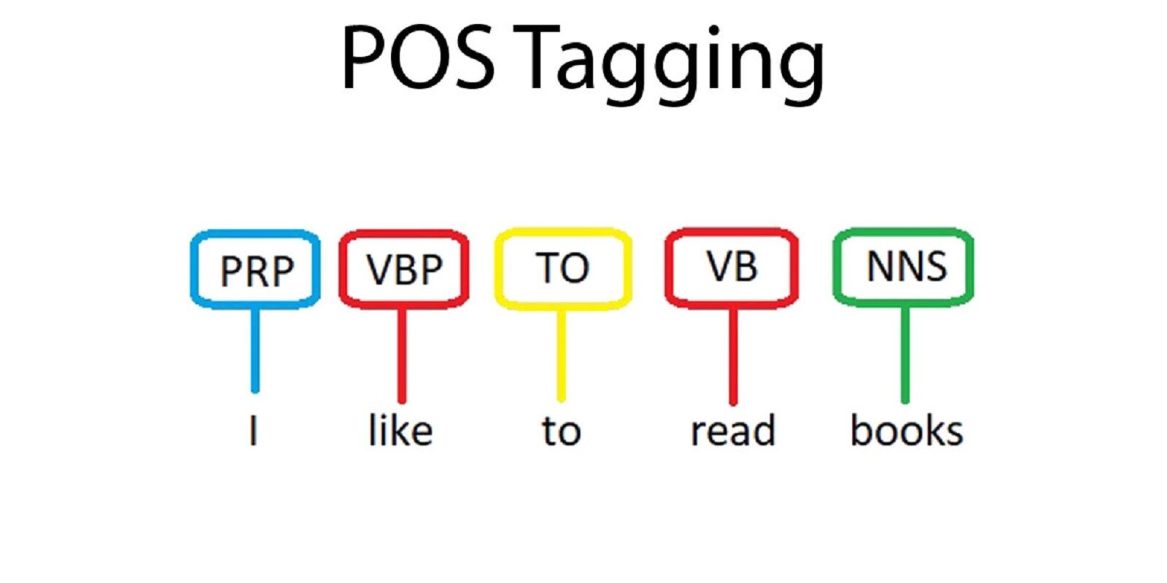
Parts of Speech Tagging
Introduce the task of part-of-speech tagging, taking a sequence of words and assigning each word a part of speech like NOUN or VERB
Task of named entity recognition (NER), assigning words or phrases tags like PERSON, LOCATION, or ORGANIZATION.

Slide 48
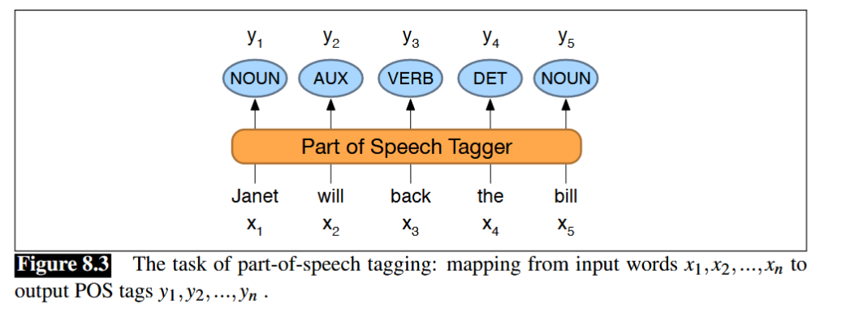
Introductions- Part-of-Speech Tagging
Part-of-speech tagging is the process of assigning a part-of-speech to each word in text.
The input is a sequence x1, x2, ..., xn of (tokenized) words and a tagset, and
the output is a sequence y1, y2, ..., yn of tags,
each output yi corresponding exactly to one input xi,

Slide 49
Introduction
Tagging is a disambiguation task; words are ambiguous —have more than one possible part-of-speech—and the goal is to find the correct tag for the situation.
For example, book can be a verb (book that flight) or
a noun (hand me that book).
That can be a determiner (Does that flight serve dinner) or
a complementizer (thought that your flight was earlier).
The goal of POS-tagging is to resolve these ambiguity , choosing the proper tag for the context.

Slide 50
Introduction to POS Tagging
Part-of-speech (POS) tagging is a process in natural language processing (NLP) where each word in a text is labeled with its corresponding part of speech.
This can include nouns, verbs, adjectives, and other grammatical categories.
POS tagging is useful for a variety of NLP tasks, such as information extraction, named entity recognition, and machine translation.
It can also be used to identify the grammatical structure of a sentence and to disambiguate words that have multiple meanings.
example,
Text: “The cat sat on the mat.”
POS tags:
The: determiner , cat: noun , sat: verb , on: preposition , the: determiner ,mat: noun

Slide 51
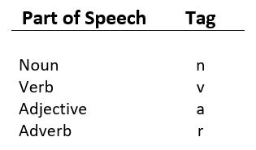
What is Part-of-speech (POS) tagging ?
It is a process of converting a sentence to forms – list of words, list of tuples (where each tuple is having a form (word, tag)).
The tag in case of is a part-of-speech tag, and signifies whether the word is a noun, adjective, verb, and so on
Part Of Speech | Tag
Noun (Singular) | NN
Noun (Plural) | NNS
Verb | VB
Determiner | DT
Adjective | JJ
Adverb | RB

Slide 52
Universal Part-of Speech Tagset
Universal Part-of-Speech Tagset
Tag | Meaning | English Examples
ADJ | adjective | new, good, high, special, big, local
ADP | adposition | on, of, at, with, by, into, under
ADV | adverb | really, already, still, early, now
CONJ | conjunction | and, or, but, if, while, although
DET | determiner, article | the, a, some, most, every, no, which
NOUN | noun | year, home, costs, time, Africa
NUM | numeral | twenty-four, fourth, 1991, 14:24
PRT | particle | at, on, out, over per, that, up, with
PRON | pronoun | he, their, her, its, my, I, us
VERB | verb | is, say, told, given, playing, would
. | punctuation marks | . , ; !
X | other | ersatz, esprit, dunno, gr8, univeristy

Slide 53
Use of Parts of Speech Tagging in NLP
To understand the grammatical structure of a sentence: By labeling each word with its POS, we can better understand the syntax and structure of a sentence.
To disambiguate words with multiple meanings: Some words, such as “bank,” can have multiple meanings depending on the context in which they are used.
To improve the accuracy of NLP tasks: POS tagging can help improve the performance of various NLP tasks, such as named entity recognition and text classification.
To facilitate research in linguistics: POS tagging can also be used to study the patterns and characteristics of language use and to gain insights into the structure and function of different parts of speech.

Slide 54
Steps Involved in the POS tagging
Collect a dataset of annotated text: This dataset will be used to train and test the POS tagger.
The text should be annotated with the correct POS tags for each word.
Preprocess the text: This may include tasks such as tokenization (splitting the text into individual words),
lowercasing, and removing punctuation.
Divide the dataset into training and testing sets: The training set will be used to train the POS tagger,
and the testing set will be used to evaluate its performance.
Train the POS tagger: This may involve building a statistical model, such as a hidden Markov model (HMM),
or defining a set of rules for a rule-based or transformation-based tagger.
The model or rules will be trained on the annotated text in the training set.
Test the POS tagger: Use the trained model or rules to predict the POS tags of the words in the testing set.
Compare the predicted tags to the true tags and calculate metrics such as precision and recall to evaluate
the performance of the tagger.
Fine-tune the POS tagger: If the performance of the tagger is not satisfactory, adjust the model or rules and
repeat the training and testing process until the desired level of accuracy is achieved.
Use the POS tagger: Once the tagger is trained and tested, it can be used to perform POS tagging on new,
unseen text.

Slide 55
Different POS Tagging Techniques
1.Rule-Based POS Tag
This is one of the oldest approaches to POS tagging.
It involves using a dictionary consisting of all the possible POS tags for a given word.
If any of the words have more than one tag, hand-written rules are used to assign the correct tag based on the tags of surrounding words.
For example, if the preceding of a word an article, then the word has to be a noun.
Consider the words: A Book
Get all the possible POS tags for individual words: A – Article; Book – Noun or Verb
Use the rules to assign the correct POS tag: As per the possible tags, “A” is an Article and we can assign it directly. But, a book can either be a Noun or a Verb. However, if we consider “A Book”, A is an article and following our rule above, Book has to be a Noun. Thus, we assign the tag of Noun to book.
POS Tag: [(“A”, “Article”), (“Book”, “Noun”)]

Slide 56
Rule-based POS Tagging
These rules may be either −
Context-pattern rules
Regular expression compiled into finite-state automata, intersected with lexically ambiguous sentence representation.
Rule-based POS tagging by its two-stage architecture −
First stage − In the first stage, it uses a dictionary to assign each word a list of potential parts-of-speech.
Second stage − In the second stage, it uses large lists of hand-written disambiguation rules to sort down the list to a single part-of-speech for each word.

Slide 57
Properties of Rule-Based POS Tagging
These taggers are knowledge-driven taggers.
The rules in Rule-based POS tagging are built manually.
The information is coded in the form of rules.
We have some limited number of rules approximately around 1000.
Smoothing and language modeling is defined explicitly in rule-based taggers.

Slide 58
Rule-based POS tagger Example
Define a set of rules for assigning POS tags to words. For example:
If the word ends in “-tion,” assign the tag “noun.”
If the word ends in “-ment,” assign the tag “noun.”
If the word is all uppercase, assign the tag “proper noun.”
If the word is a verb ending in “-ing,” assign the tag “verb.”
Iterate through the words in the text and apply the rules to each word in turn. For example:
“Nation” would be tagged as “noun” based on the first rule.
“Investment” would be tagged as “noun” based on the second rule.
“UNITED” would be tagged as “proper noun” based on the third rule.
“Running” would be tagged as “verb” based on the fourth rule.
Output the POS tags for each word in the text.

Slide 59
Stochastic POS Tagging
Another technique of tagging is Stochastic POS Tagging. Now, the question that arises here is which model can be stochastic.
The model that includes frequency or probability (statistics) can be called stochastic.
Any number of different approaches to the problem of part-of-speech tagging can be referred to as stochastic tagger.
The simplest stochastic tagger applies the following approaches for POS tagging −
Word Frequency Approach
In this approach, the stochastic taggers disambiguate the words based on the probability that a word occurs with a particular tag. We can also say that the tag encountered most frequently with the word in the training set is the one assigned to an ambiguous instance of that word. The main issue with this approach is that it may yield inadmissible sequence of tags.
Tag Sequence Probabilities
It is another approach of stochastic tagging, where the tagger calculates the probability of a given sequence of tags occurring. It is also called n-gram approach. It is called so because the best tag for a given word is determined by the probability at which it occurs with the n previous tags.

Slide 60
Statistical POS Tagging
Statistical part-of-speech (POS) tagging is a method of labeling words with their corresponding parts of speech using statistical techniques.
This is in contrast to rule-based POS tagging, which relies on pre-defined rules, and to unsupervised learning-based POS tagging, which does not use any annotated training data.
In statistical POS tagging, a model is trained on a large annotated corpus of text to learn the patterns and characteristics of different parts of speech.
The model uses this training data to predict the POS tag of a given word based on the context in which it appears and the probability of different POS tags occurring in that context.
Statistical POS taggers can be more accurate and efficient than rule-based taggers, especially for tasks with large or complex datasets.

Slide 61
Transformation-based tagging (TBT)
Transformation-based tagging (TBT) is a method of part-of-speech (POS) tagging that uses a series of rules to transform the tags of words in a text.
This is in contrast to rule-based POS tagging, which assigns tags to words based on pre-defined rules, and to statistical POS tagging, which relies on a trained model to predict tags based on probability.

Slide 62
Working Principles
Here is an example of how a TBT system might work:
Define a set of rules for transforming the tags of words in the text. For example:
If the word is a verb and appears after a determiner, change the tag to “noun.”
If the word is a noun and appears after an adjective, change the tag to “adjective.”
Iterate through the words in the text and apply the rules in a specific order. For example:
In the sentence “The cat sat on the mat,” the word “sat” would be changed from a verb to a noun based on the first rule.
In the sentence “The red cat sat on the mat,” the word “red” would be changed from an adjective to a noun based on the second rule.
Output the transformed tags for each word in the text.

Slide 63
Hidden Markov Model POS tagging
Hidden Markov models (HMMs) are a type of statistical model that can be used for part-of-speech (POS) tagging in natural language processing (NLP).
In an HMM-based POS tagger, a model is trained on a large annotated corpus of text to learn the patterns and characteristics of different parts of speech.
The model uses this training data to predict the POS tag of a given word based on the probability of different tags occurring in the context of the word.

Slide 64
Challenges in POS Tagging
Ambiguity: Some words can have multiple POS tags depending on the context in which they appear, making it difficult to determine their correct tag. For example, the word “bass” can be a noun (a type of fish) or an adjective (having a low frequency or pitch).
Out-of-vocabulary (OOV) words: Words that are not present in the training data of a POS tagger can be difficult to tag accurately, especially if they are rare or specific to a particular domain.
Complex grammatical structures: Languages with complex grammatical structures, such as languages with many inflections or free word order, can be more challenging to tag accurately.
Lack of annotated training data: Some languages or domains may have limited annotated training data, making it difficult to train a high-performing POS tagger.
Inconsistencies in annotated data: Annotated data can sometimes contain errors or inconsistencies, which can negatively impact the performance of a POS tagger.

Slide 65
STUDENT EVALUATION
1) What is the main challenges of NLP?
A. Handling Tokenization B. Handling POS-Tagging
C. Handling Ambiguity of Sentences D. None of the above
2) All of the following are challenges associated with natural language processing
except
A. dividing up a text into individual words in English. B. understanding the context in which something is said.
C. recognizing typographical or grammatical errors in texts D. distinguishing between words that have more than one meaning
3) In linguistic morphology, _____________ is the process for reducing inflected words
to their root form.
A. Stemming B. Rooting
C. Text-Proofing D.Both A and B
4) Morphological Segmentation
A. Is an extension of propositional logic
B. Does Discourse Analysis
C. Separate words into individual morphemes and identify the class of the morphemes
D. None of the mentioned

Slide 66
What are MWEs?
Multiword expressions (MWEs) are expressions which are made up of at least 2 words and which can be syntactically and/or semantically idiosyncratic in nature.
Sequence of words that has lexical, orthographic, phonological, morphological, syntactic, semantic, pragmatic or translational properties not predictable from the individual components or their normal mode of combination

Slide 67
MWE
sequence of
Not necessarily contiguous in a concrete utterance
Not necessarily always in the same order in each utterance
words
Ambiguity between type and token (intentional)
Inflected word form v. lemma
Ambiguity between
Character sequences separated from other character sequences by spaces and other separators (Narrow interpretation)
Abstract lexical units of the grammar (Broad interpretation)
that has properties not predictable from the individual components and their normal mode of combination

Slide 68
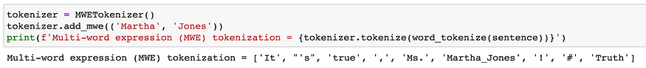
MWETokenizer
The multi-word expression tokenizer is a rule-based, “add-on” tokenizer offered by NLTK. Once the text has been tokenized by a tokenizer of choice, some tokens can be re-grouped into multi-word expressions.
For example, the name Martha Jones is combined into a single token instead of being broken into two tokens. This tokenizer is very flexible since it is agnostic of the base tokenizer that was used to generate the tokens.

Slide 69
Student Evaluation
1.N-grams are defined as the combination of N keywords together. How many bi-grams can be generated from the given sentence: The Father of our nation is Mahatma Gandhiji
A.8 B.9
C.7 D.4
2. It is the development of probabilistic models that are able to predict the next word in the sequence given the words that precede.
A. Statistical Language Modelling B. Probabilistic Langualge Modeling
C. Neural Language Modelling D. Natural Language Understanding
3. It is a measure of how good a probability distribution predicts a sample
A. Entropy B. Perplexity
C. Cross-Entropy D. Information Gain
4.What are the python libraries used in NLP?
A. Pandas B. NLTK
C. Spacy D. All the mentioned above

Slide 70
Vector representation of words in NLP
In Natural Language Processing (NLP), vector representation of words is a crucial concept used to convert words into numerical vectors. These vector representations are also known as word embeddings.
Word embeddings are essential because they capture semantic and syntactic relationships between words and enable machine learning models to process and understand natural language text.
There are several methods to create word embeddings, and some of the commonly used techniques include:
One-Hot Encoding: In one-hot encoding, each word in the vocabulary is represented as a binary vector where all elements are zero except for the index corresponding to the word's position in the vocabulary, which is set to 1.
This method creates sparse and high-dimensional vectors that lack meaningful semantic relationships between words.

Slide 71
Techniques used
Word2Vec: Word2Vec is a popular word embedding technique that learns continuous word representations from large amounts of text data. It offers two algorithms: Continuous Bag of Words (CBOW) and Skip-gram. These models generate dense word vectors that capture semantic similarities between words based on their context.
GloVe (Global Vectors for Word Representation): GloVe is another widely used method for learning word embeddings. It combines the global co-occurrence statistics of words in a corpus to create word vectors. GloVe embeddings capture both semantic and syntactic relationships between words.
Fast Text: Fast Text is an extension of Word2Vec that represents each word as a bag of character n-grams. It can generate word embeddings for out-of-vocabulary words based on their character-level information, making it useful for handling misspellings and rare words.

Slide 72
Word 2 Vector Techniques
BERT (Bidirectional Encoder Representations from Transformers): BERT is a transformer-based model that generates contextual word embeddings. Unlike traditional methods that generate static embeddings, BERT considers the context of the word within the sentence, producing highly contextualized word representations.
ELMo (Embeddings from Language Models): ELMo is another contextual word embedding model that uses a bi-directional language model. It generates word embeddings based on the entire context of the sentence, capturing the polysemy (multiple meanings) of words.
ULMFiT (Universal Language Model Fine-tuning): ULMFiT is a transfer learning approach for NLP that utilizes pre-trained language models to fine-tune embeddings for specific downstream tasks. It enables efficient training on smaller datasets.
These word embeddings can be used as input features for various NLP tasks, such as sentiment analysis, machine translation, named entity recognition, and more.
They help improve the performance of NLP models by providing a more compact and meaningful representation of words in numerical form.

Slide 73
Word 2 Vector Example
Let's demonstrate a simple example of word embeddings using Word2Vec, one of the popular techniques for learning word representations. For this example, we will use a small dataset of movie reviews and create word embeddings using the Word2Vec algorithm.
Step 1: Preprocess the Data Suppose we have the following movie reviews:
"The movie was fantastic, with amazing special effects."
"The plot was engaging and kept me hooked till the end."
"The acting was superb, especially by the lead actor."
"The film had stunning visuals and great cinematography."
We need to preprocess the data by tokenizing the sentences and converting the text to lowercase
Step 2: Train Word2Vec Model Next, we train a Word2Vec model using the tokenized reviews
Step 3: Retrieve Word Embeddings Now, we can access the word embeddings for specific words using the trained Word2Vec model
Step 4: Similar Words We can also find words similar to a given word based on their embeddings
Step 5: Word Similarity Additionally, we can measure the similarity between two words

Slide 74
Word 2 Vector Example
The resulting word embeddings and similarity scores will depend on the specific corpus and the number of training iterations, but they should capture the semantic relationships between words based on their context in the reviews.
For instance, "fantastic" and "amazing" are likely to have a high similarity score, as they both frequently appear together in positive contexts in the dataset. Similarly, "plot" and "visuals" might also have a reasonable similarity score if they co-occur in sentences discussing movie elements.

Slide 75
Language modelling in NLP
Language modeling is a fundamental task in Natural Language Processing (NLP) that involves building a statistical model to predict the probability distribution of words in a given language.
The language model learns the patterns and relationships between words in a corpus of text and can be used to generate new text, evaluate the likelihood of a sentence, perform speech recognition, machine translation.
In language modeling, the primary goal is to estimate the probability of a sequence of words (a sentence or a phrase) using the conditional probability of each word given its preceding context.
The model learns from large amounts of text data to predict the likelihood of a particular word given the previous words in a sentence.

Slide 76
Language modelling in NLP
There are different types of language models, but two prominent approaches are
N-gram Language Models
Neural Language Models
N-gram Language Models: N-gram language models are simple and widely used in early NLP tasks. An N-gram model predicts the probability of a word based on the previous (N-1) words in a sentence.
For example, a trigram model (3-gram) predicts the probability of a word given the two preceding words. The model estimates the probabilities based on the frequency of word sequences observed in the training data.
Neural Language Models: Neural language models, such as recurrent neural networks (RNNs) and transformer-based models, have gained significant popularity in recent years due to their ability to capture long-range dependencies and contextual information
These models learn complex patterns in the language and can generate more coherent and contextually relevant text.

Slide 77
Language modelling in NLP
Recurrent Neural Networks (RNNs): RNNs are a class of neural networks designed for sequential data processing. They process input sequences step by step, maintaining a hidden state that captures information from previous steps.
This hidden state acts as the context for the current word prediction. However, RNNs have challenges with capturing long-range dependencies and can suffer from vanishing or exploding gradients.
Transformer-based Models: Transformer-based models, like the famous BERT (Bidirectional Encoder Representations from Transformers) and GPT (Generative Pre-trained Transformer) series, have revolutionized language modeling.

Slide 78
REFERENCE
These are slides by stanford for all topics –
https://web.stanford.edu/~jurafsky/NLPCourseraSlides.html
2) This is e book which can be followed
https://web.stanford.edu/~jurafsky/slp3/ed3book.pdf
3) This is the channel by dan jurafsky and manning where they teach each topic from zero level.
https://www.youtube.com/watch?v=808M7q8QX0E&list=PLaZQkZp6WhWyvdiP49JG-rjyTPck_hvEu
4) https://www.shiksha.com/online-courses/articles/pos-tagging-in-nlp/
5) https://web.stanford.edu/~jurafsky/slp3/

